Slide 1

Dell EMC Streaming Data Analytics - Hands-on
王超
戴尔易安信研发中心 产品技术顾问

Slide 2
Demo介绍
本地运行InfluxDB+Grafana
本地部署Pravega
本地部署IoT GW
通过本地电脑连接树莓派Pi，运行传感器采集程序
本地IDE运行(Or提交到Flink本地集群)Flink Distance Calculation Job
Fixed window
计算窗口（3s）平均距离
Distance Calculation
Normal: <=1m
A little Far: > 1m && <= 3m
Far: > 3m
Demo代码：
https://github.com/1984chaowang/DistanceCalculation

Slide 3






Demo环境
PKS
Sensors
DELL EMC Streaming Data Platform
Apache Flink
Simulator

Slide 4


Workload Flow
通过Pravega Reader API读取数据
定义固定时间窗口进行计算，执行Demo应用逻辑
输出计算结果到Influx DB
实时消费MQTT topic中的数据
通过Pravega Writer API将数据实时写入到Demo Stream中
IoT GW
Distance Calculation Job
Demo Stream
InfluxDB
M
Q
T
T
Sensors
距离传感器数据实时通过树莓派Pi写入到MQTT的topic

Slide 5
工具准备
MobaXterm
https://mobaxterm.mobatek.net/download.html
FireFox
https://www.mozilla.org/en-US/firefox/new/
IntelliJ IDEA Community
https://www.jetbrains.com/idea/download/#section=windows
Java SDK 8
https://www.oracle.com/technetwork/java/javase/downloads/jdk8-downloads-2133151.html

Slide 6
运行环境准备
Open Java 8
http://openjdk.java.net/install/
Docker CE
https://docs.docker.com/install/linux/docker-ce/ubuntu/
Docker Registry server
https://docs.docker.com/registry/deploying/
Docker Compose
https://docs.docker.com/compose/install/
Notes:
Installing OpenJava8
sudo apt-get install openjdk-8-jre
Installing Docker in Ubuntu
Disco 19.04
Cosmic 18.10
Bionic 18.04 (LTS)
Xenial 16.04 (LTS)
#Uninstall old version
sudo apt-get remove docker docker-engine docker.io containerd runc
#Install using the repository
1. sudo apt-get update
2. sudo apt-get install apt-transport-https ca-certificates curl gnupg-agent software-properties-common
3. curl -fsSL https://download.docker.com/linux/ubuntu/gpg | sudo apt-key add -
4. sudo add-apt-repository “deb [arch=amd64] https://download.docker.com/linux/ubuntu $(lsb_release -cs) stable“
5. sudo apt-get update
6. sudo apt-get install docker-ce docker-ce-cli containerd.io
Installing Docker Registry server
1. docker run -d -e REGISTRY_HTTP_ADDR=0.0.0.0:5000 -p 5000:5000 --restart=always --name registry registry:2
2. Edit /etc/docker/daemon.json and add
{ "insecure-registries" : ["localhost:5000"] }
Installing Compose
sudo curl -L "https://github.com/docker/compose/releases/download/1.25.3/docker-compose-$(uname -s)-$(uname -m)" -o /usr/local/bin/docker-compose
sudo chmod +x /usr/local/bin/docker-compose

Slide 7
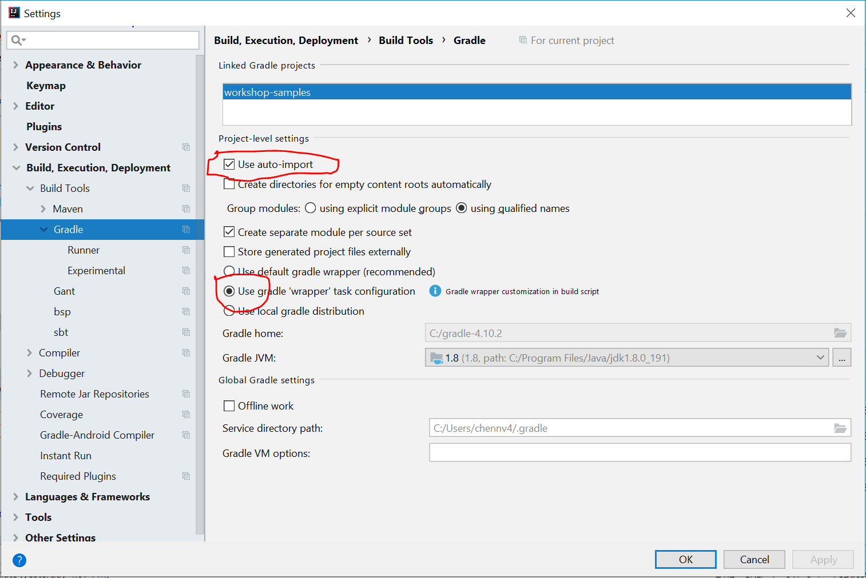
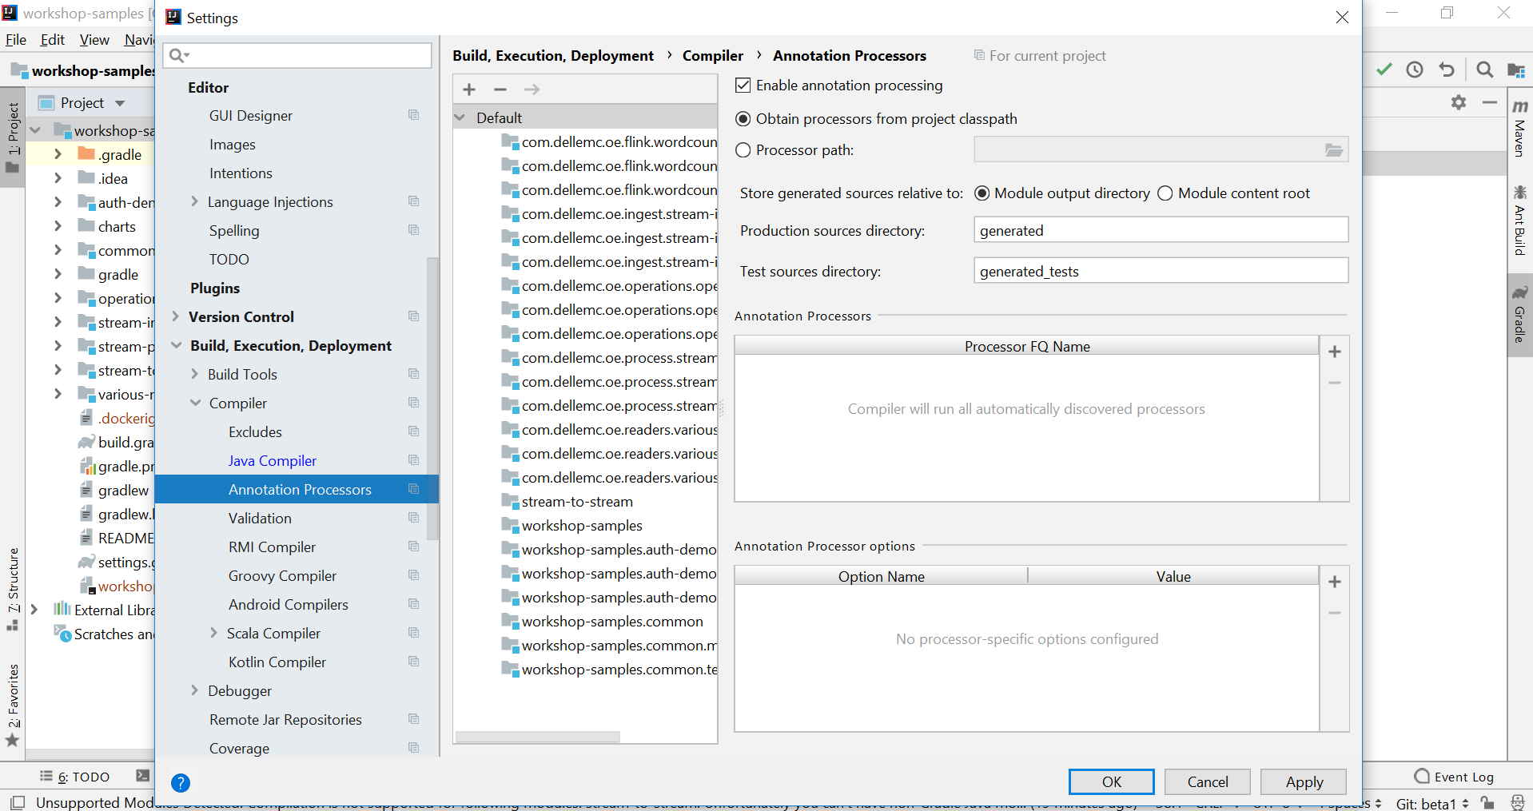
How to setup IDE
Select Project → File → settings → plugins and install Lombok plugin
Select Project → File → settings → Build,Execution,Deployment → Annotation Process
Select Project → File → settings → Build Tools → Gradle

Slide 8
修改部署配置文件 – docker-compose.yml
主要修改网络相关参数, 指定IP为运行环境中的可用IP（不可为127.0.0.1）
Services
Pravega
environment:
HOST_IP: 192.168.188.130
mqttwriter:
environment:
MQTT_BROKER_URL: tcp://192.168.188.130:1883
pravegagw:
environment:
PRAVEGA_CONTROLLER: tcp://192.168.188.130:9090
MQTT_BROKER_URL: tcp://192.168.188.130:1883
Grafana
./Visualization/Config/influxdb-datasource.yaml
url: http://192.168.188.130:8086

Slide 9

本地部署IoT GW/Pravage/Prageva/InfluxDB+Grafana
通过github下载代码
进入工作目录
cd /home/ubuntu/piedpiper/DistanceCalculation/
部署
运行 docker-compose up 或者 docker-compose up –d (后台执行)
查看
docker-compose ps
卸载
docker-compose down

Slide 10
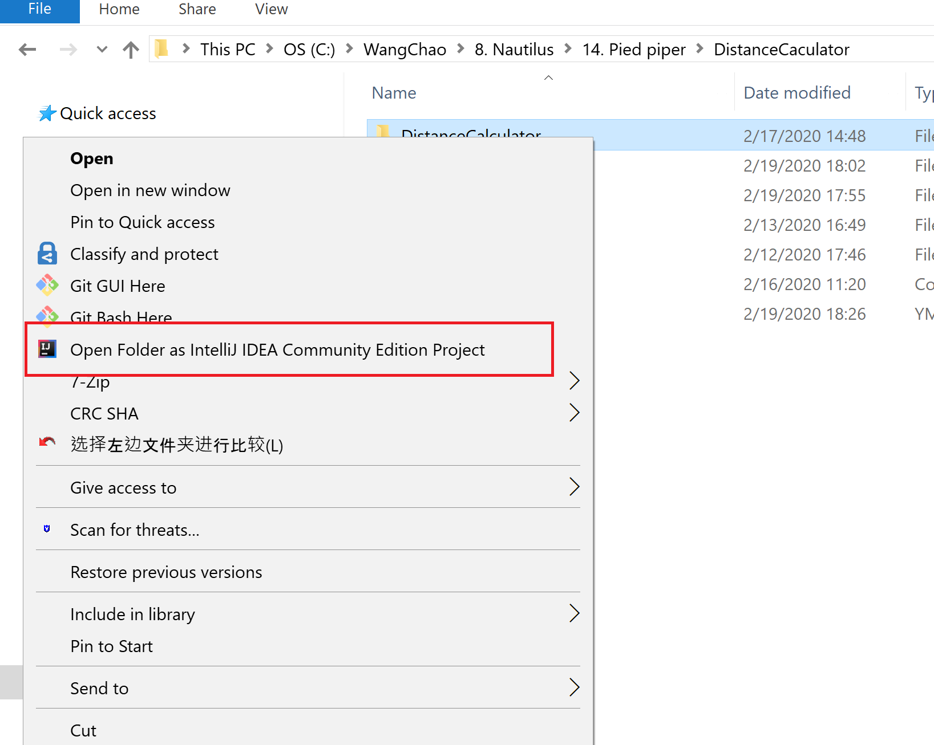
本地IDE运行Flink Distance Calculation Job -（1）
使用IntelliJ IDEA打开Flink Distance Calculation project

Slide 11
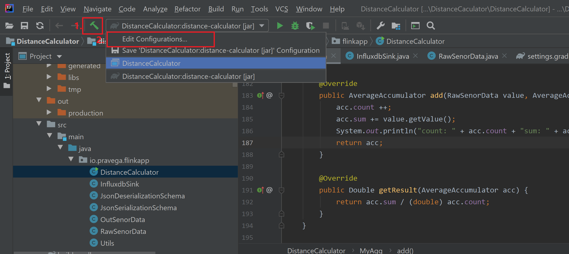
本地IDE运行Flink Distance Calculation Job -（2）
新建配置执行任务

Slide 12
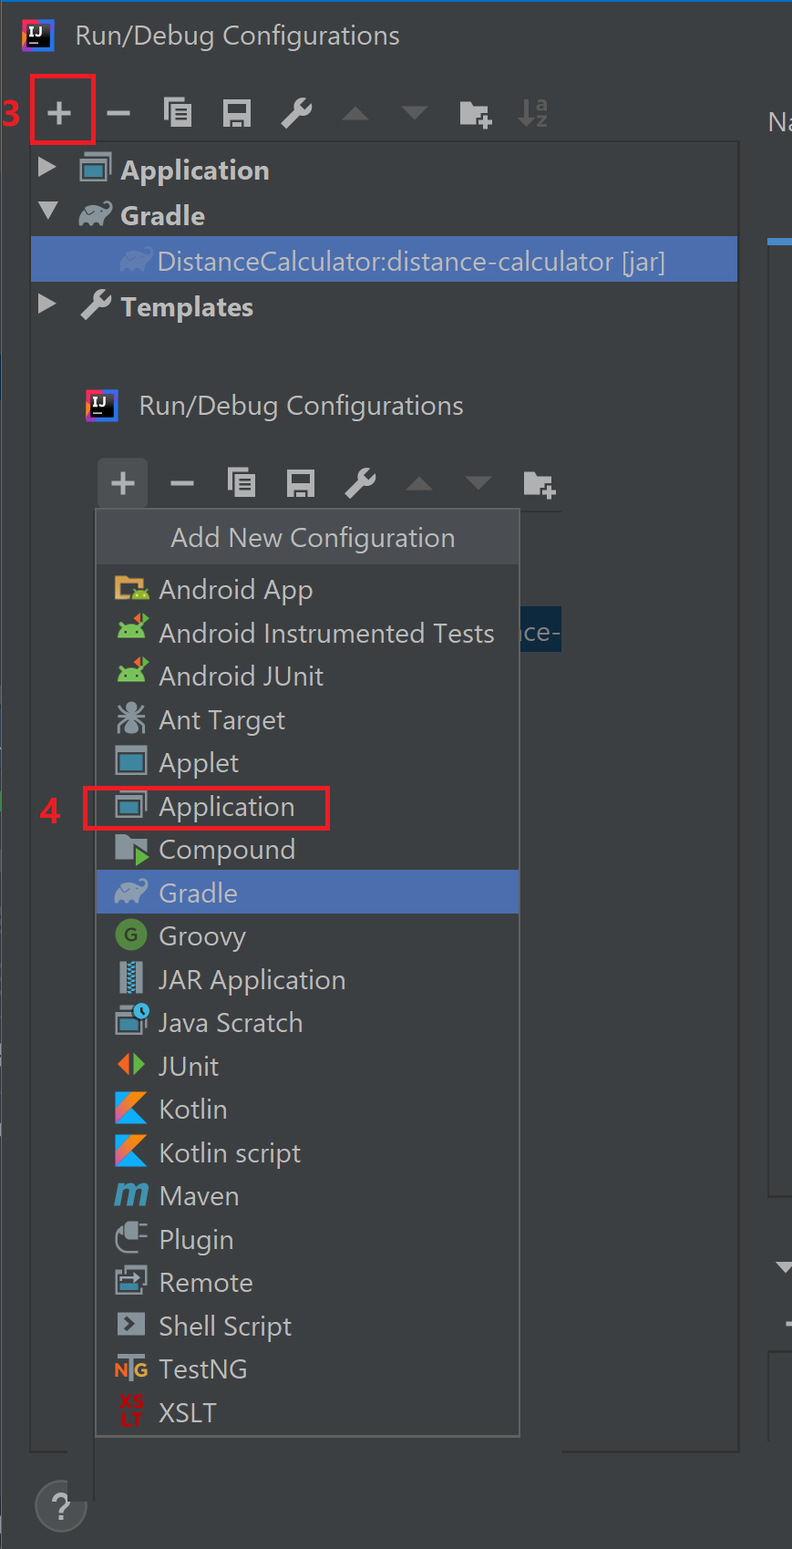
本地IDE运行Flink Distance Calculation Job -（3）
新建配置执行任务

Slide 13
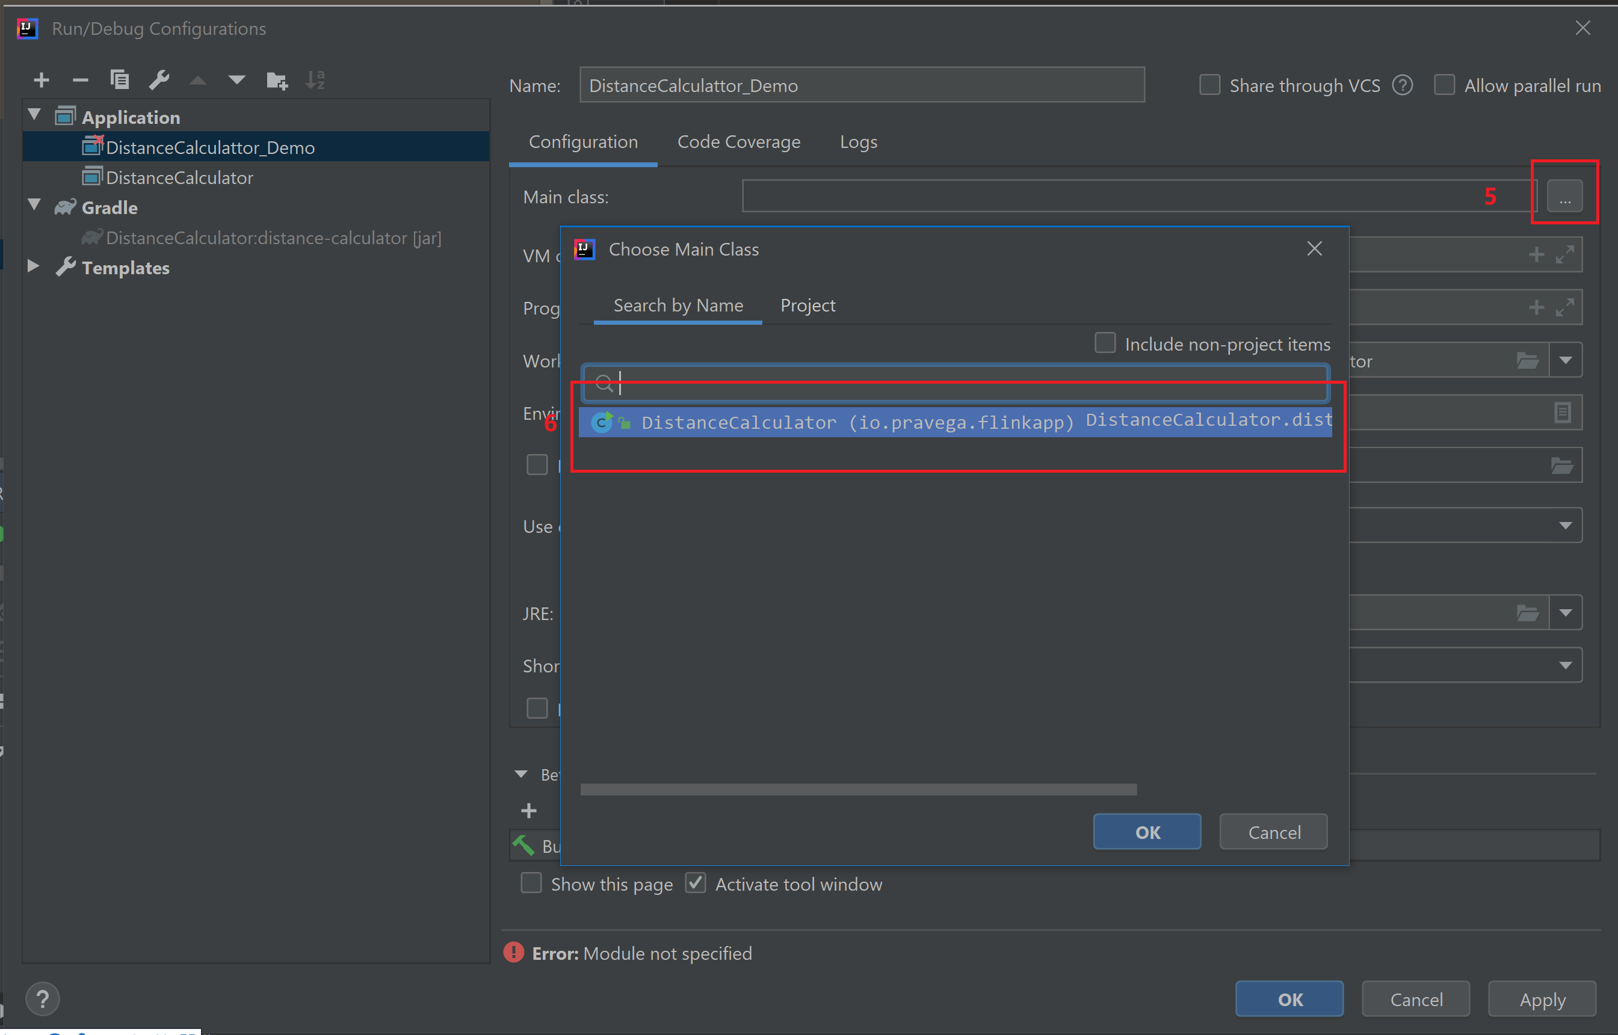
本地IDE运行Flink Distance Calculation Job -（4）
新建配置执行任务

Slide 14
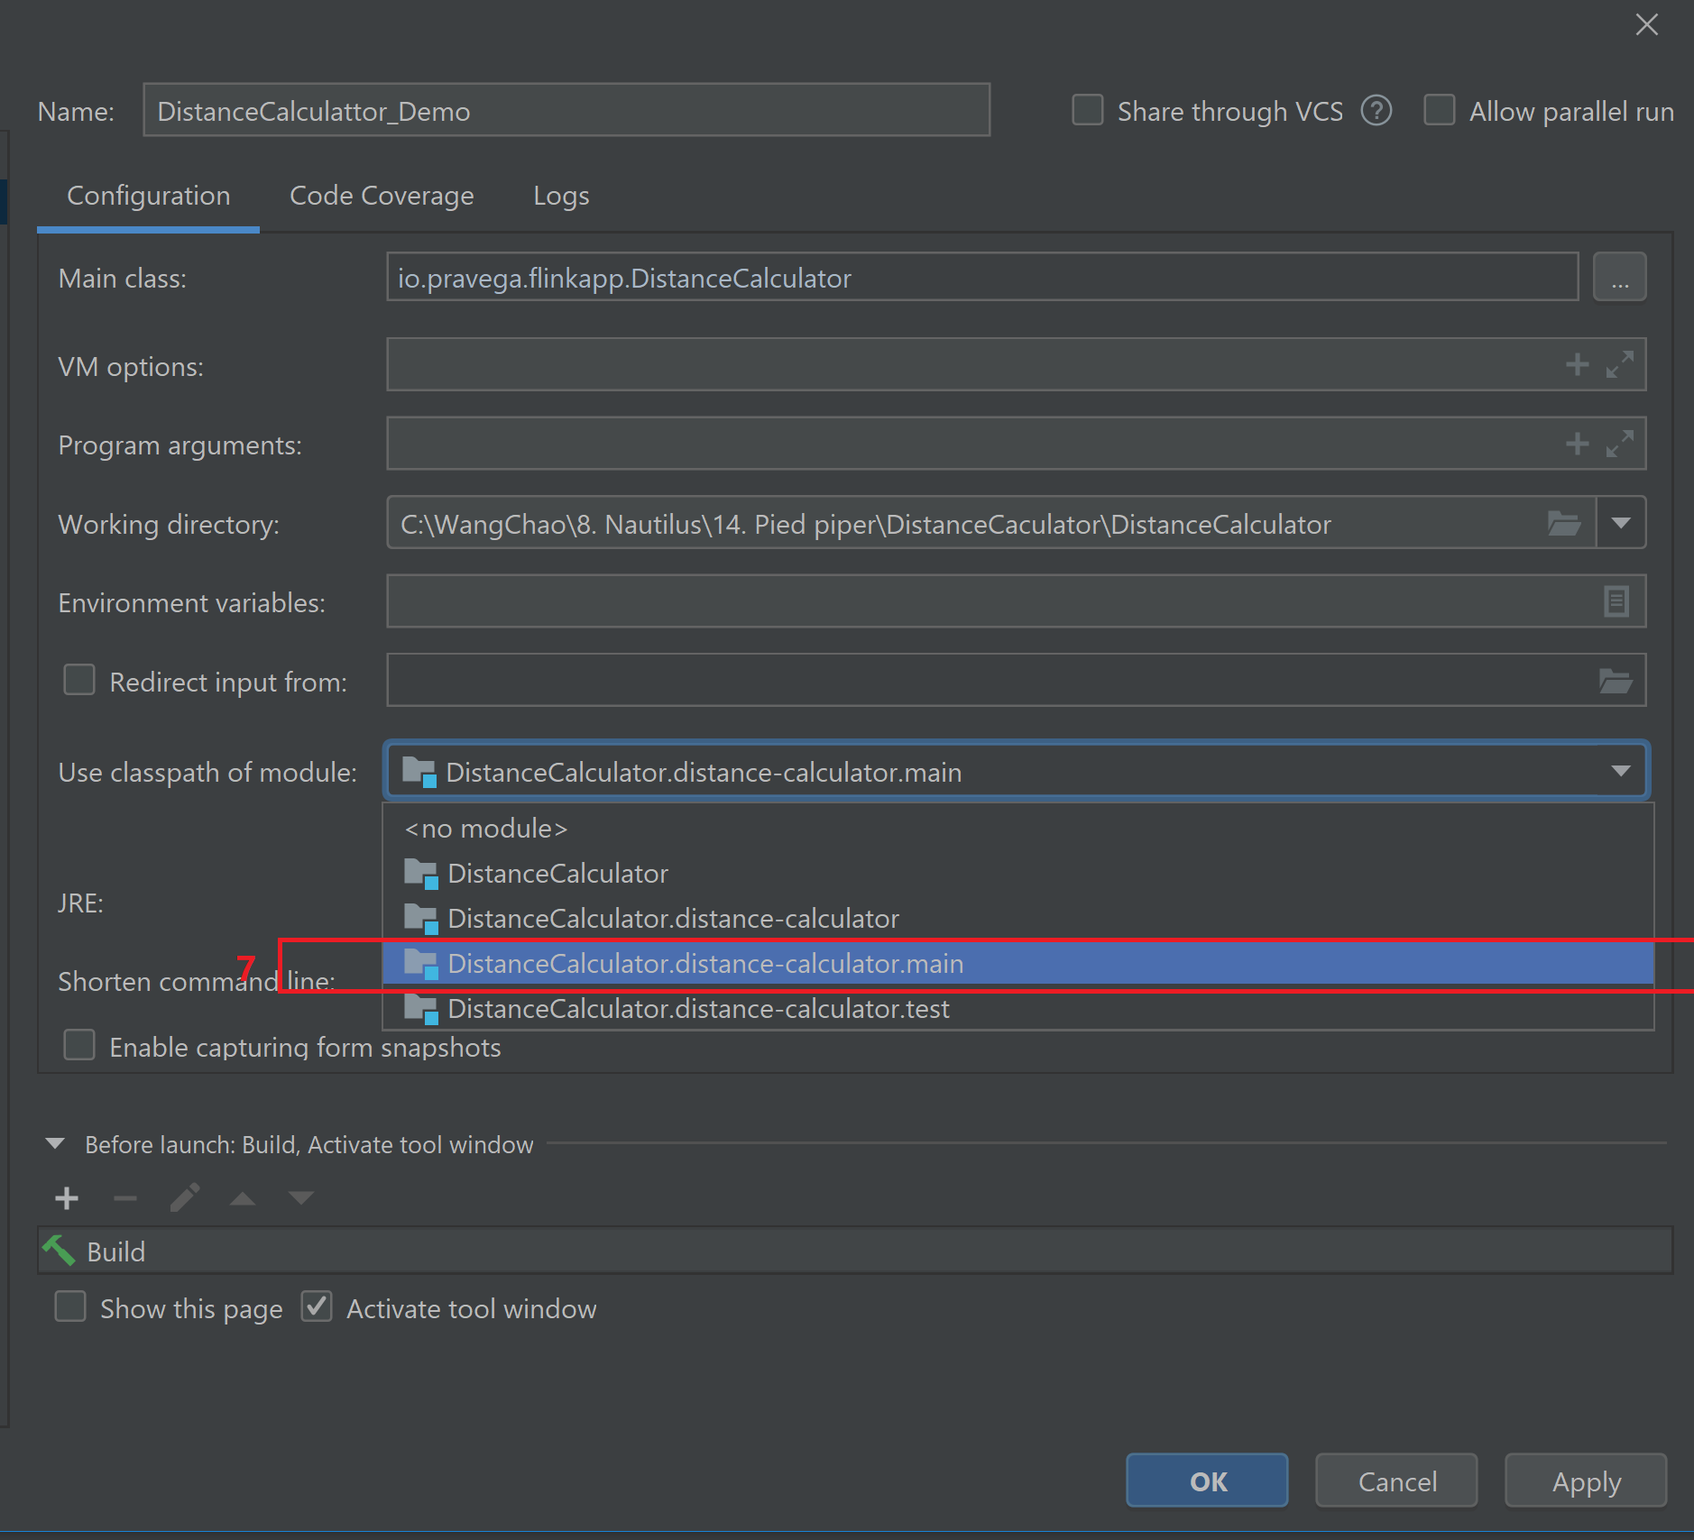
本地IDE运行Flink Distance Calculation Job -（5）
新建配置执行任务

Slide 15
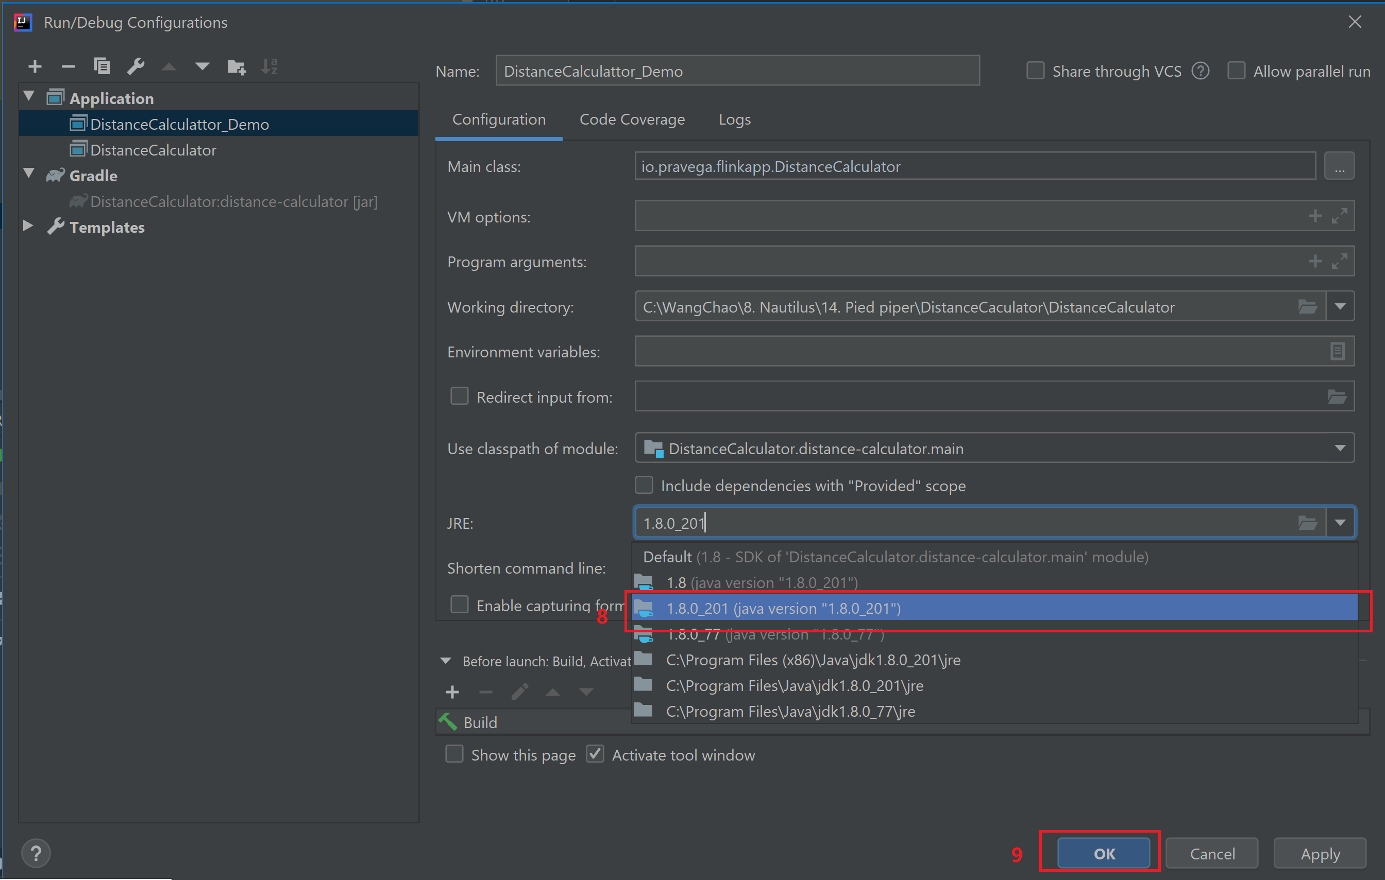
本地IDE运行Flink Distance Calculation Job -（6）
新建配置执行任务

Slide 16
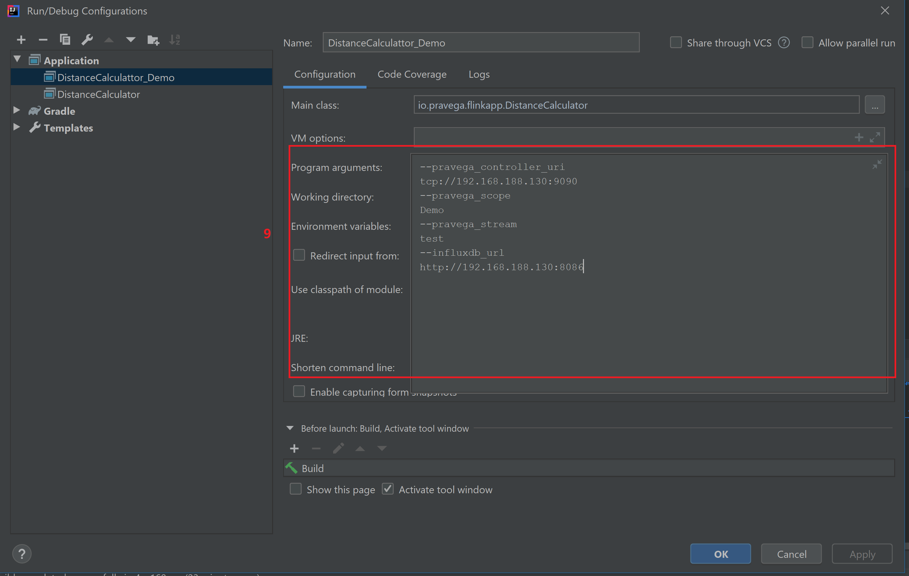
本地IDE运行Flink Distance Calculation Job -（7）
新建配置执行任务

Slide 17
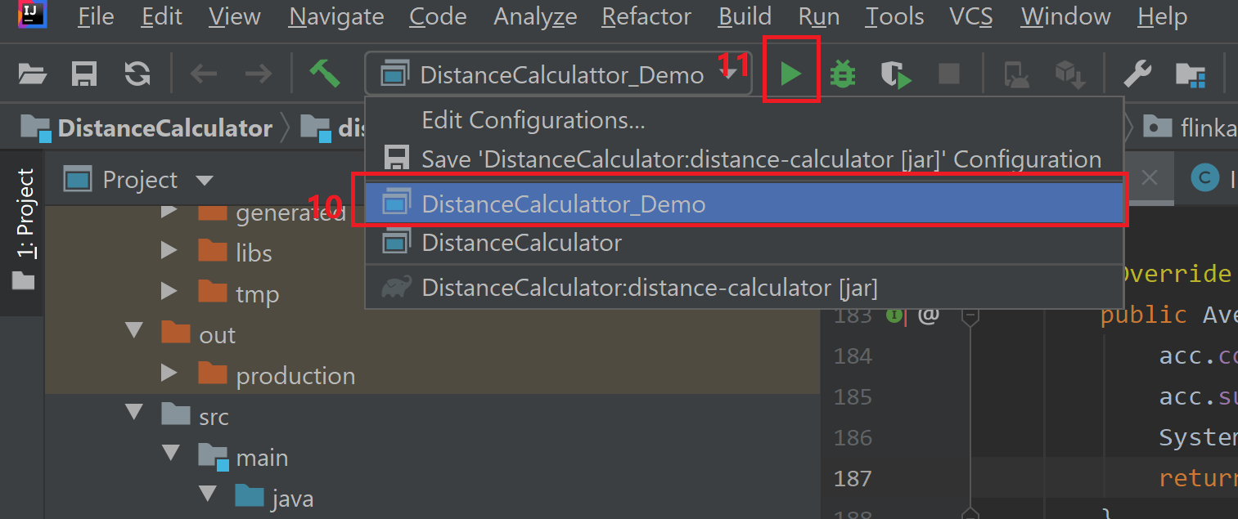
本地IDE运行Flink Distance Calculation Job -（8）
运行任务

Slide 18
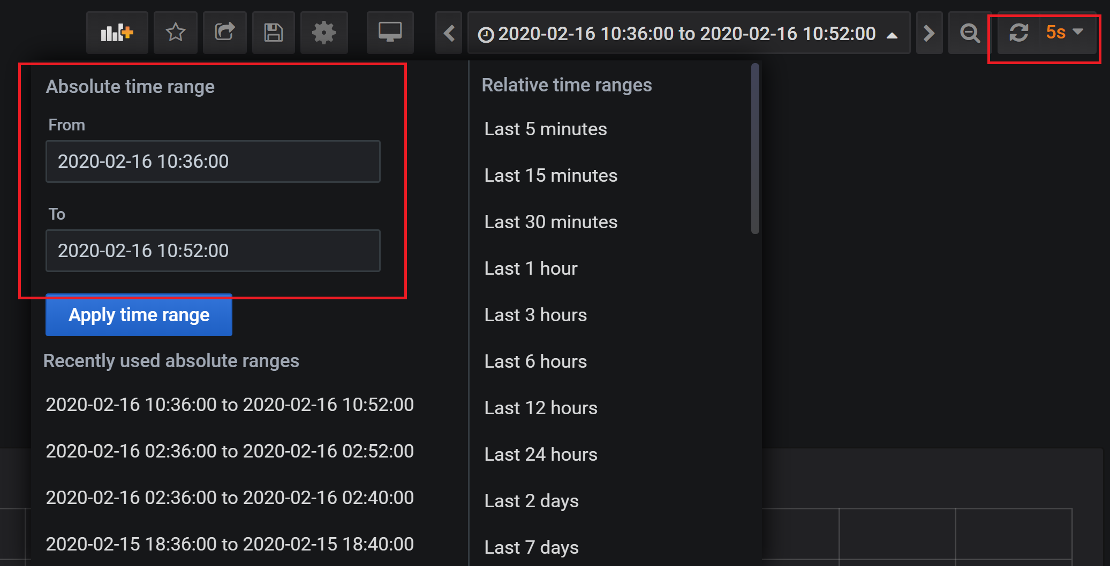
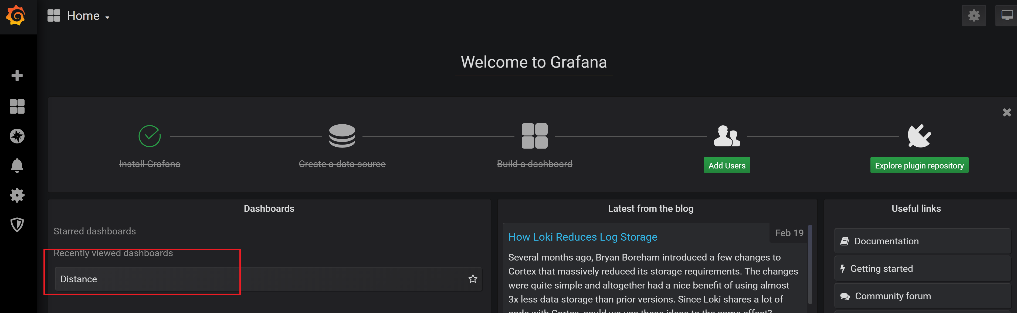
通过grafana查看
查看计算结果
登录http://<运行环境可用Host IP>:3000，打开Grafana dashboard，选择dashboard“Distance”
可选：修改显示时间区间和刷新时间 （如果使用的是模拟数据）
或者直接访问 http://<运行环境可用Host IP>:3000/d/7jAI6_-Wk/distance?orgId=1&from=1581820530000&to=1581821760000&refresh=5s
用户名密码为：admin/password

Slide 19
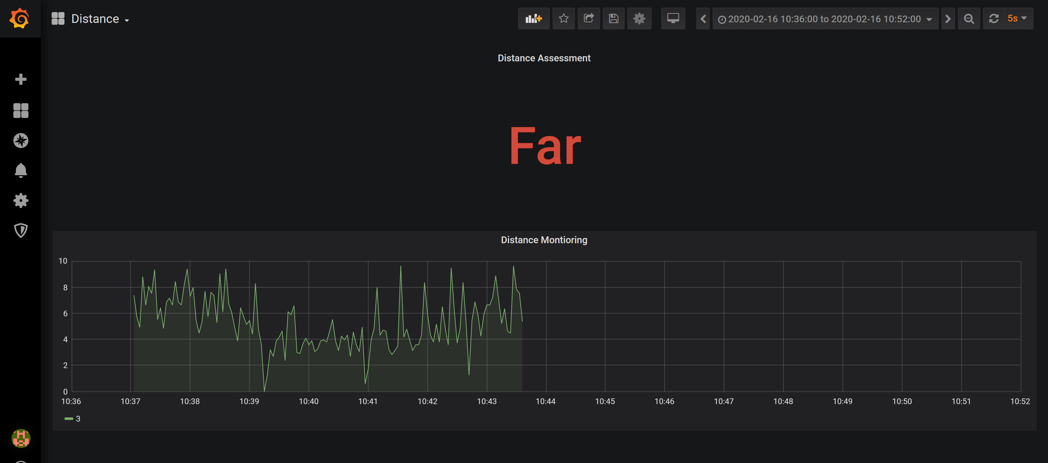
呈现结果

Slide 20
本地部署Fink cluster
下载部署配置文件
git clone https://github.com/docker-flink/examples.git
cd ./examples
部署Flink cluster
docker-compose up
OR
后台部署Flink cluster
docker-compose up
集群TaskManagers扩缩容
docker-compose scale taskmanager=<N>
卸载 the cluster
docker-compose kill/docker-compose down
Notes:
Usage
Launch a cluster in the foreground
docker-compose up
Launch a cluster in the background
docker-compose up -d
Scale the cluster up or down to N TaskManagers
docker-compose scale taskmanager=<N>
Kill the cluster
docker-compose kill
When the cluster is running, you can visit the web UI at http://localhost:8081. You can also use the web UI to submit a job to a session cluster.
To submit a job to a session cluster via the command line, you must copy the JAR to the JobManager container and submit the job from there.
For example:
$ JOBMANAGER_CONTAINER=$(docker ps --filter name=jobmanager --format={{.ID}}) $ docker cp path/to/jar "$JOBMANAGER_CONTAINER":/job.jar $ docker exec -t -i "$JOBMANAGER_CONTAINER" flink run /job.jar

Slide 21
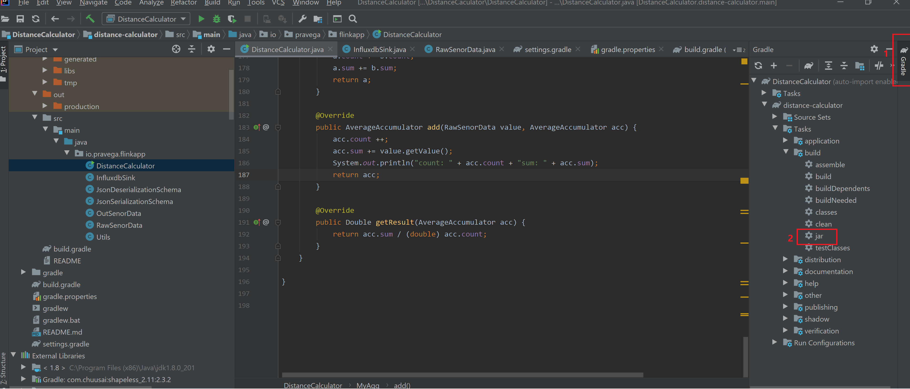
打包Flink Job应用 - （1）
基于本地IDE运行Flink Distance Calculation Job -（1）
在IDE执行Jar打包任务

Slide 22
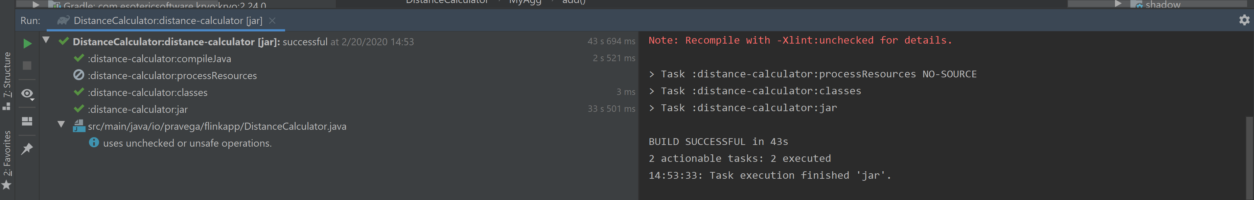
打包Flink Job应用 - （2）
当任务执行完成，在该项目的工作目录“DistanceCalculator\distance-calculator\build\libs”能获得distance-calculator-4.0.jar

Slide 23

上传Flink App到Flink cluster
登录Flink http://<运行环境可用Host IP >:8081

Slide 24
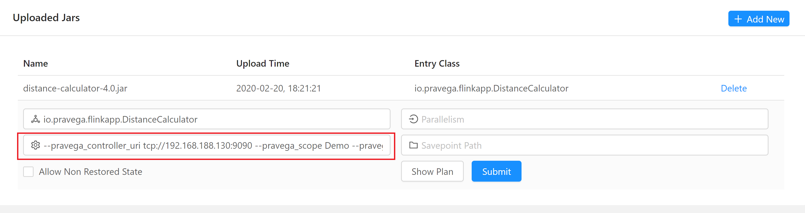
运行Flink App
依照本地IDE运行Flink Distance Calculation Job -（7）输入应用运行参数。

